Slide 1
Final Project
Fake News Detection
Tran Nguyen Thai Nguyen
Python for Data Science class 20

Slide 2

Definition of fake news
Untrue information presented as news. It often has the aim of damaging the reputation of a person or entity, or making money through advertising revenue.

Slide 3
01
DEFINE THE PROBLEM
ABSTRACT
02
LIBRARY AND DATASET
03
TF-IDF VECTORIZER, PASSIVE AGGRESSIVE CLASSIFERS
04
ALTERNATIVE ALGORITHMS
05
CONCLUSION

Slide 4

DEFINE THE PROBLEM
RReal
Tranform Data to vectors by using TF-IDF Vectorizer
Outcome
Fake
Use Passive Aggressive Classifier Algorithm
To Predict Fake News
RAW DATA
(FEATURES)
Titles of News
Brief of news’ content
Labels: FAKE, REAL

Slide 5
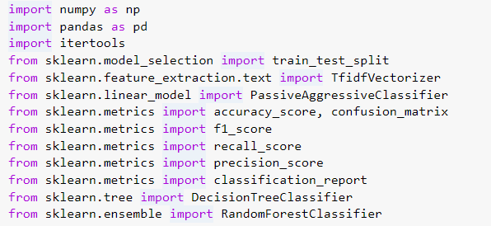
IMPORT LIBRARY

Slide 6
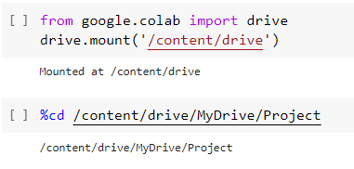
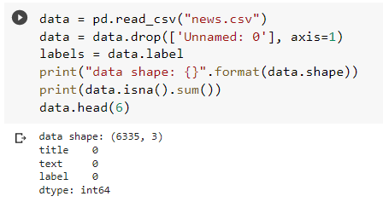
PREPROCESS DATA
Load dataset
Access dataset

Slide 7
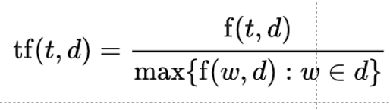
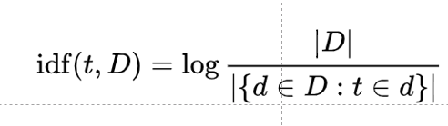

PREPROCESS DATA
Convert Dataset To Usable Data (Vectors) By Using TF - IDF Vectorizer
Term - Frequency (TF):
counts the number of appearance of a word in a document.
Inverse Document Frequency (IDF):
Measures the rank of the specific word for its relevancy within the text.
TF - IDF measures how important a word in a given document.

Slide 8


DATASET ANALIZED
FEATURES (INPUTS)
Titles of News
Brief of news’ content
Labels: FAKE, REAL
OUTPUTS
Fake OR Real
Data’ Shape
6335 x3

Slide 9
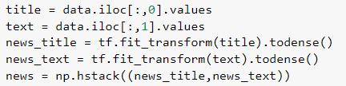

TF-IDF Vectorizer
Convert Dataset To Usable Data (Vectors) By Using TF - IDF Vectorizer
Initialize the Vectorizer
Transform titles and texts to vectors
New shape of the dataset

Slide 10
TF-IDF Vectorizer
Convert Dataset To Usable Data (Vectors) By Using TF - IDF Vectorizer
Initialize the Vectorizer
Transform titles and texts to vectors
New shape of the dataset

Slide 11
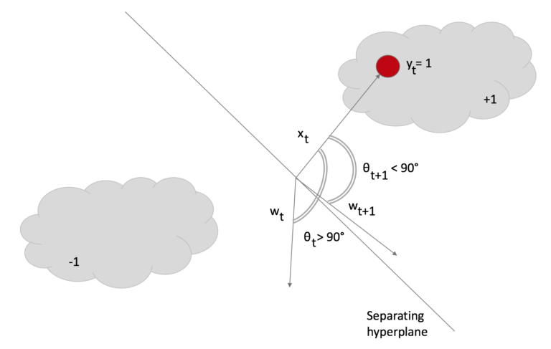
Main Algorithm
Passive Aggressive Classifier is an online learning algorithm where you train a system incrementally by feeding it instances sequentially, individually or in small groups called mini-batches.
Passive-aggressive classifier for embedded devices

Slide 12
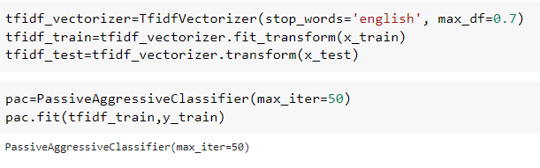
Data Processing, Applied PAC
Divide Dataset into training and validation set
Initialize Passive Agressive Classifier and fit training data

Slide 13
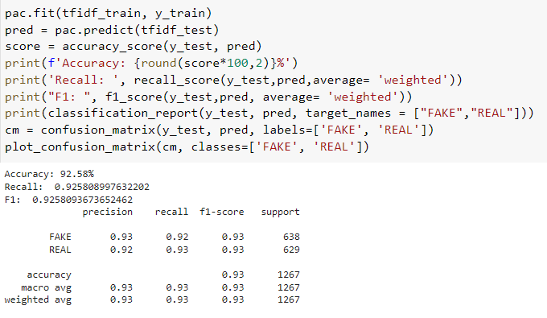
Results

Slide 14
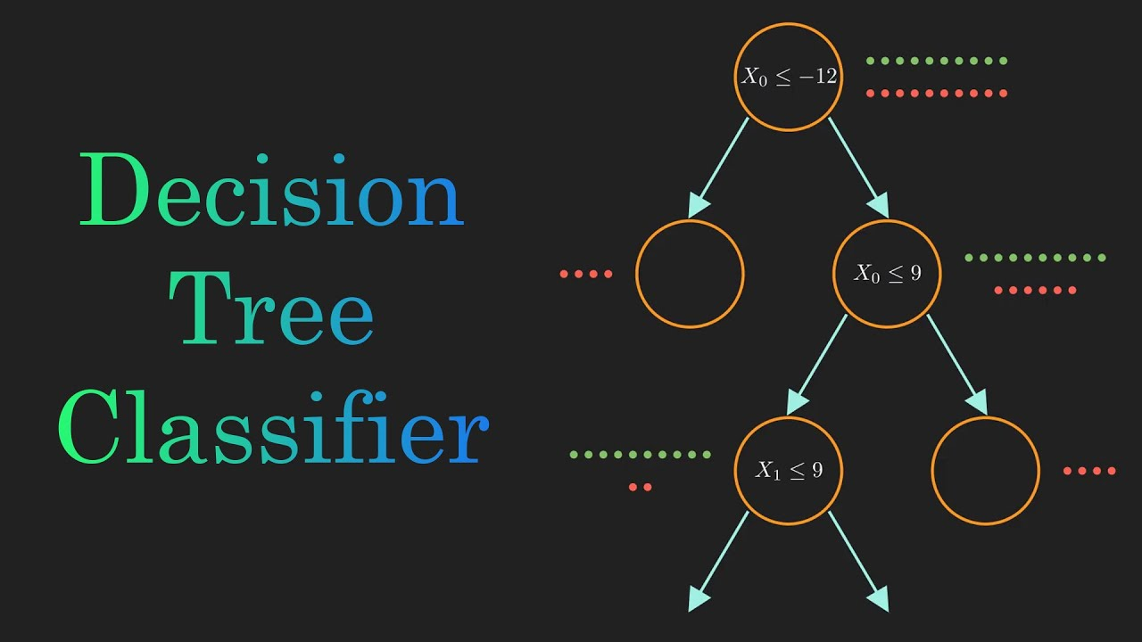
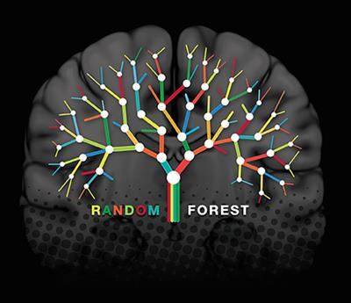
Other Algorithms
Decision Tree Classifier :
a tree-structured classifier, where internal nodes represent the features of a dataset, branches represent the decision rules and each leaf node represents the outcome
Random Forrest Classifier:
A random forest is a meta estimator that fits a number of decision tree classifiers on various sub-samples of the dataset and uses averaging to improve the predictive accuracy and control over-fittin

Slide 15
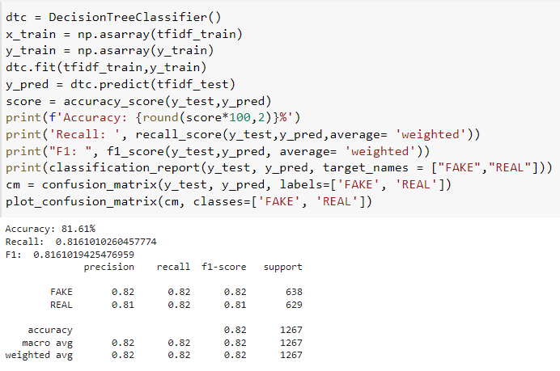
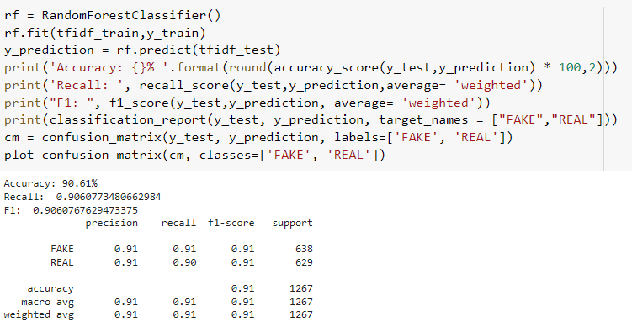
Results
Decision Tree Classifier
Random Forrest Classifier

Slide 16
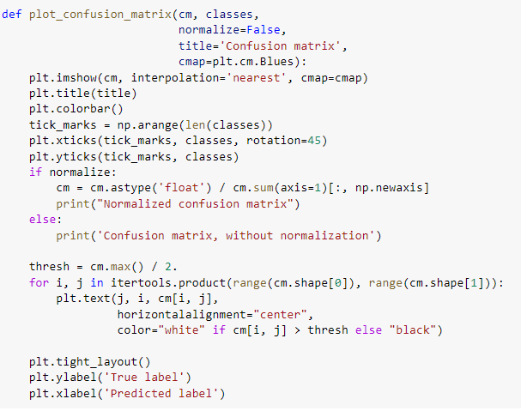
Plot The Confusion Matrix

Slide 17
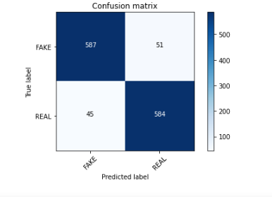
Plot Breakdown
This is a Comfusion Matrix( Without Normalization) Plot:
- Two classes in the plot : True and Fake
- True and predicted labels values are displayed in different colors

Slide 18
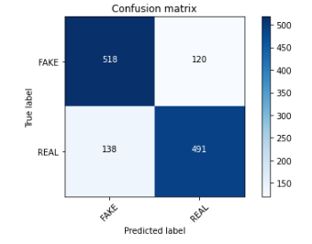
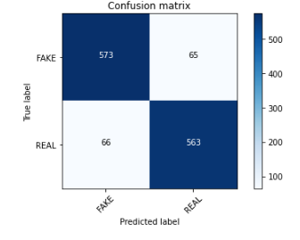
Comparison
Passive Aggresive Classifier
Decision Tree Classifier
Random Forrest Classifier
Accuracy: 92.58%
Accuracy: 81.61%
Accuracy: 90.61%

Slide 19


Conclusion
Algorithms | Accuracy
Passive Aggressive Classifer | 92,58%
Decision Tree Classifier | 81,61%
Random Forrest Classifier | 90,61%
Passive Aggressive Classifier has is the most accurate among the 3 algorithms (almost 93%)
=> Suitable for this particular model
Almost 93%
PAC

Slide 20
THANK YOU
Hope You Will Do Well In Upcoming Journeys

